Slide 1
PROJECT ON RELIANCE STOCK DATA

Slide 2
Team 4
Mentor – Bapuram Pallavi and Madishetti Rajashekar
From: 08-02-2023 to 14-03-2023
Members of the Team
VENKATESH SALMETA
DIVYA TALAKOLA
MEDIDI JAYANTH RAMA KRISHNA
DARA ARUN KUMAR
KONKA ROHAN

Slide 3
OBJECTIVE
Predict the Reliance Industries Stock Price for the next 30 days.
There are Open, High, Low and Close prices that you need to obtain from the web for each day starting from 2015 to 2022 for Reliance Industries stock.
Split the last year into a test set- to build a model to predict stock price.
Find short term, & long term trends.
Understand how it is impacted from external factors or any big external events.
Forecast for next 30 days.

Slide 4
Data set Details
We got data from yfinance module.
Shape of the data is (1975,6).
Data has no Null values.
Variables from the data Open price, High Price, Low Price, Close Price and Adj Close have high correlation between themselves.
Volume turned out to be an outlier.

Slide 5
EXPLORATORY DATA ANALYSIS
Exploratory Data Analysis (EDA) is an approach to analyze the data using visual techniques. It is used to discover trends, patterns, or to check assumptions with the help of statistical summary and graphical representations.
TYPES OF EXPLORATORY DATA ANALYSIS:
Univariate Non-graphical
Multivariate Non-graphical
Univariate graphical
Multivariate graphical
Univariate Non-graphical: The standard goal of univariate non-graphical EDA is to know the underlying sample distribution/ data and make observations about the population. Outlier detection is additionally part of the analysis. The characteristics of population distribution include: Skewness, Kurtosis, Central tendency, Spread.
Multivariate Non-graphical: Multivariate non-graphical EDA technique is usually wont to show the connection between two or more variables within the sort of either cross-tabulation or statistics.

Slide 6
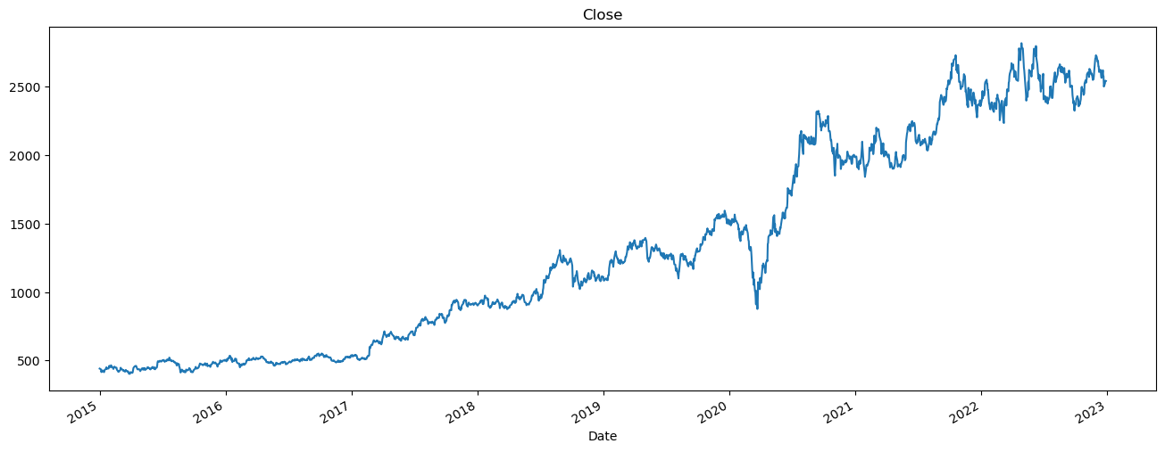
Historical view of close price

Slide 7
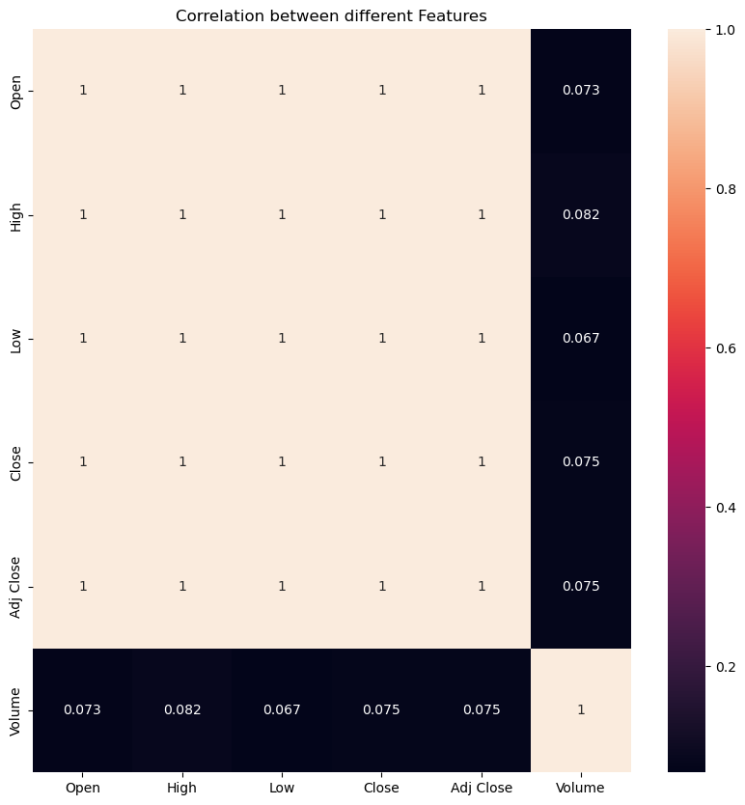
Heat Map

Slide 8
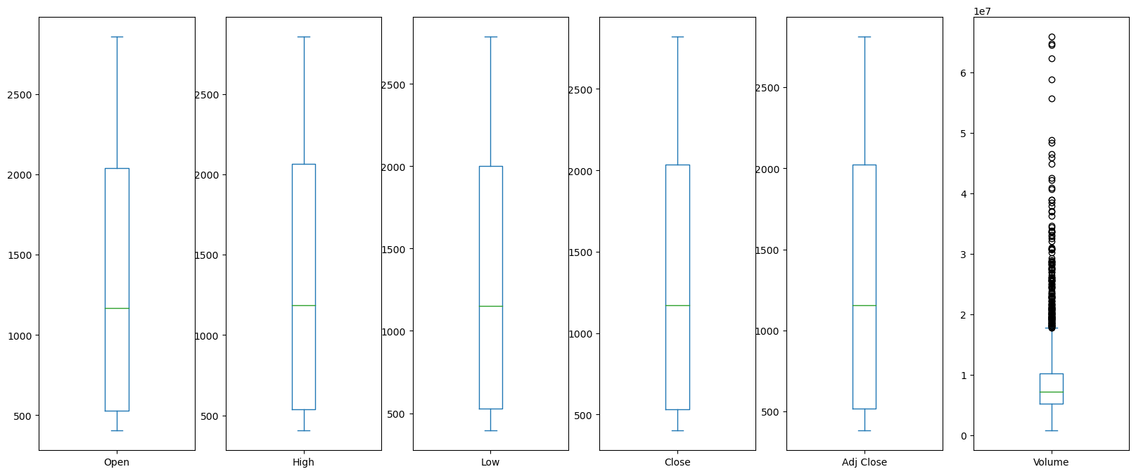
BOXPLOT

Slide 9
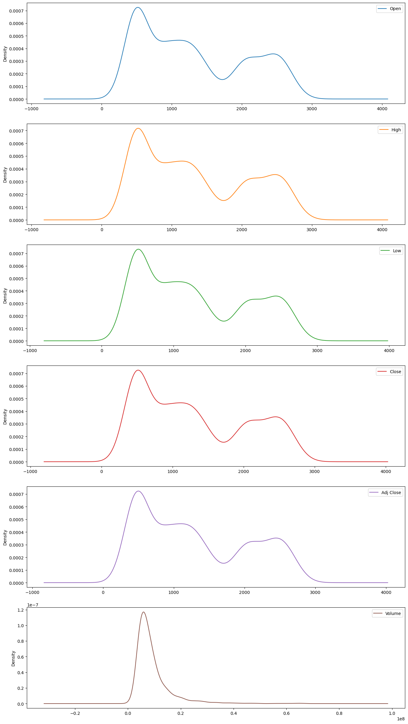
Density Plot

Slide 10
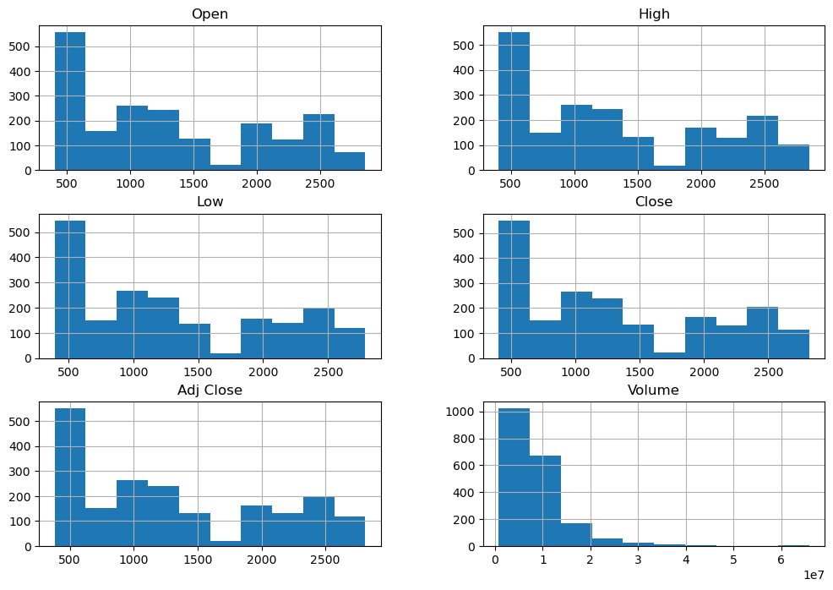
HISTOGRAM

Slide 11
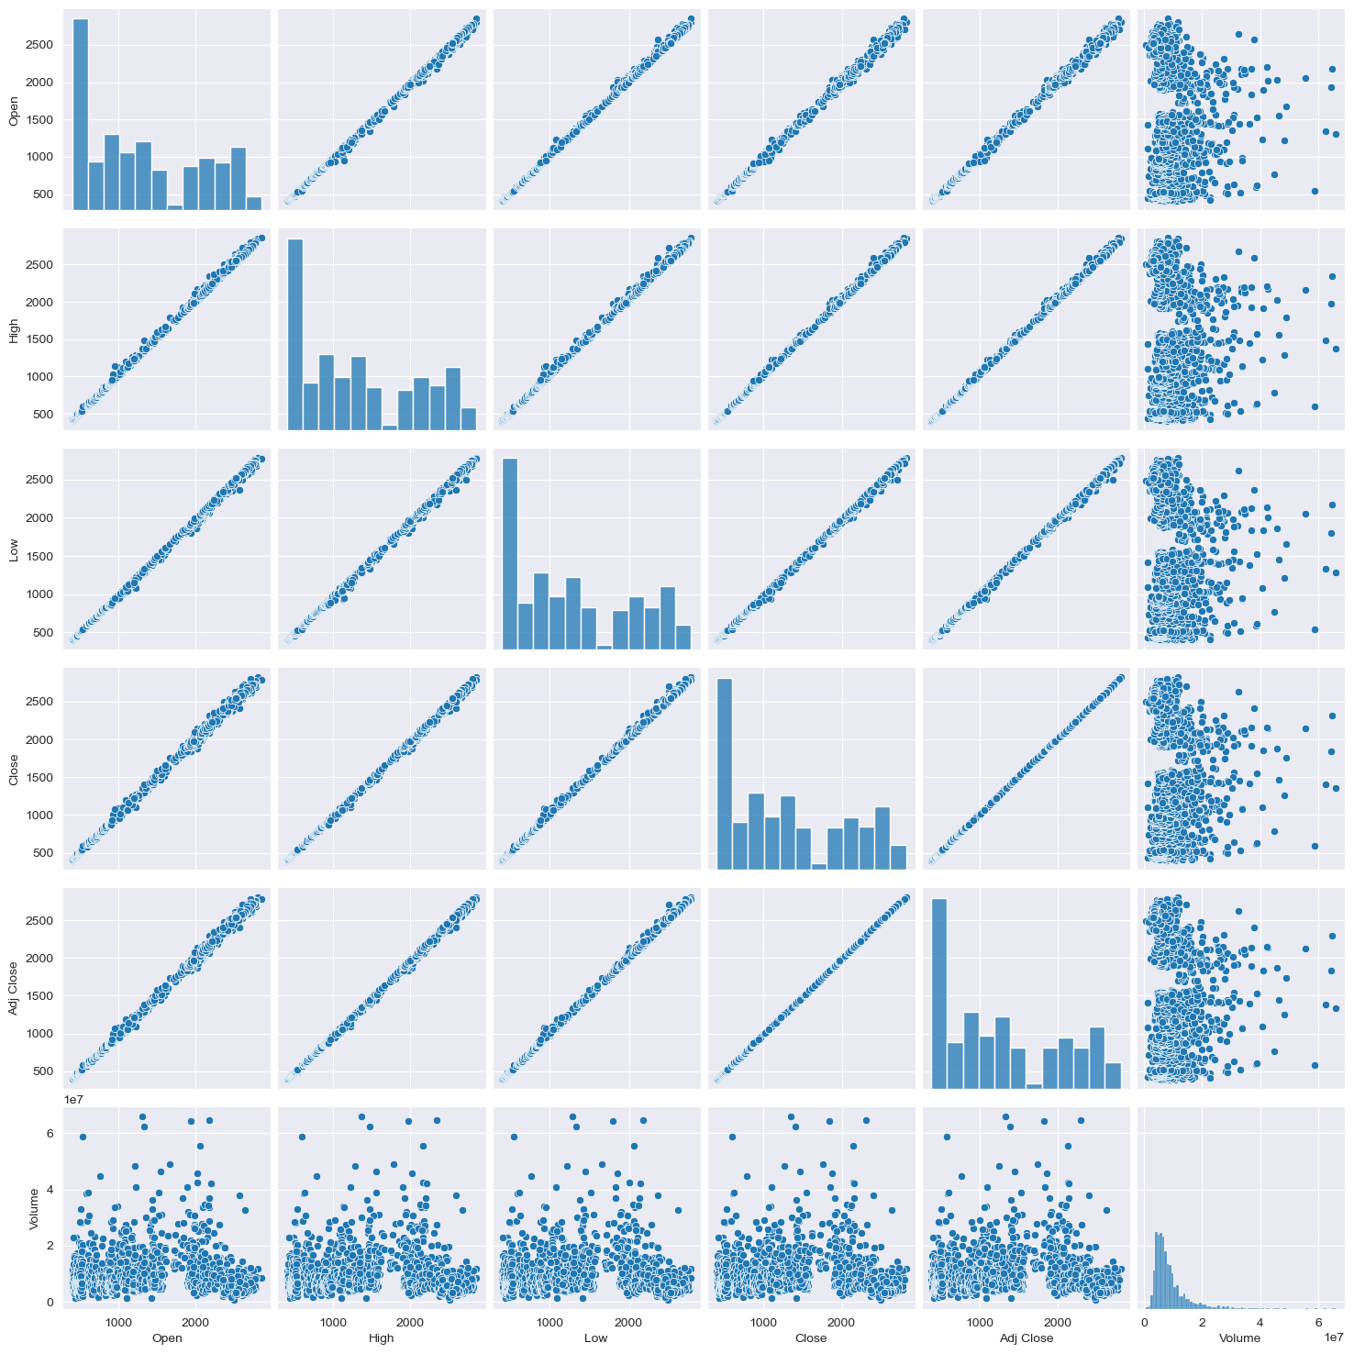
PAIR PLOT

Slide 12
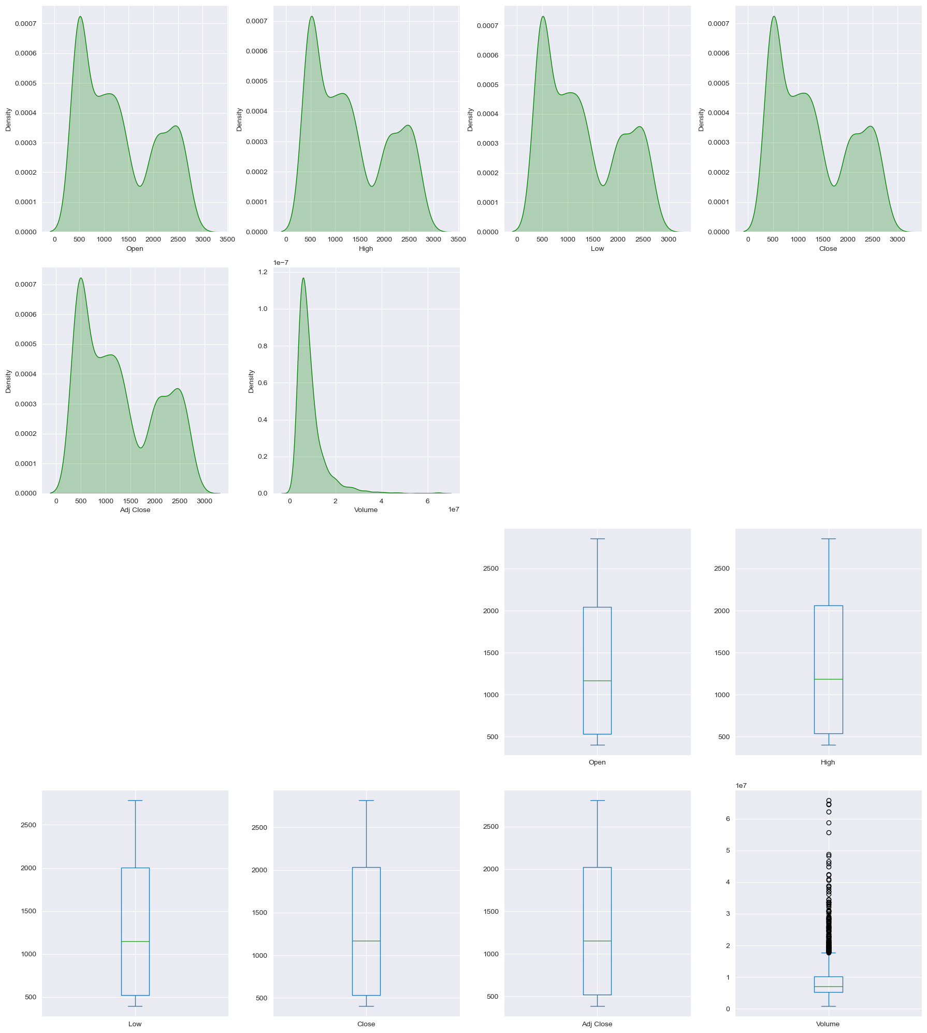
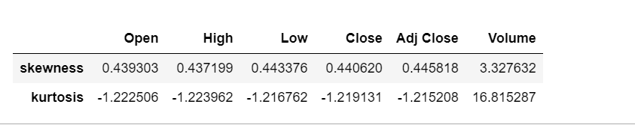
Skewness And Kurtosis

Slide 13
AUTO EDA
We have understood techniques used in EDA, which is manually done with the help of some libraries. For quick analysis with the help of these four excellent tools, you can quickly gain an understanding of your data, including a summary of all columns, the number of missing values, the skewness of your dataset, and much more.
Pandas Profiling: Pandas Profiling is a simple-to-use open source Python package for exploratory data analysis. It produces a report of your dataframe in a variety of formats. While the pandas df.describe function is excellent, it does not provide a detailed report of your dataframe, you can perform a quick data analysis using Pandas profiling.
Sweetviz: Sweetviz is a free, open-source Python library that generates beautiful, high-density visualizations for exploratory data analysis with only a few lines of code. The result will be generated as a html file, so you have to check your notebook files.
Dtale: D-Tale combines a Flask back-end and a React front-end to provide an easy-to-use interface for viewing and analyzing Pandas data structures. It integrates with ipython notebooks and python/ipython terminals seamlessly. This tool currently supports the following Pandas objects: DataFrame, Series, Multi Index, DatetimeIndex, and RangeIndex. As with Pandas profiling, it supports a variety of visualizations, including heatmaps, charts, and three-dimensional plots.
AutoViz: AutoViz automatically visualizes any dataset with a single line of code. AutoViz is capable of identifying the most critical features and plotting visually compelling visualizations solely on the basis of those automatically selected features. Additionally, AutoViz is lightning fast, generating visualization in a matter of seconds.

Slide 14
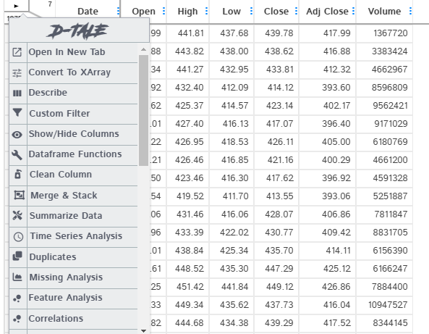

d-tale

Slide 15
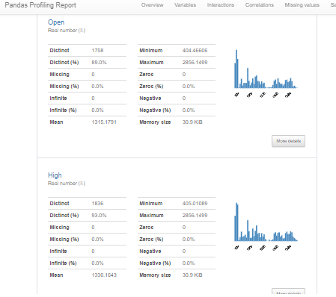
PANDASPROFLING

Slide 16
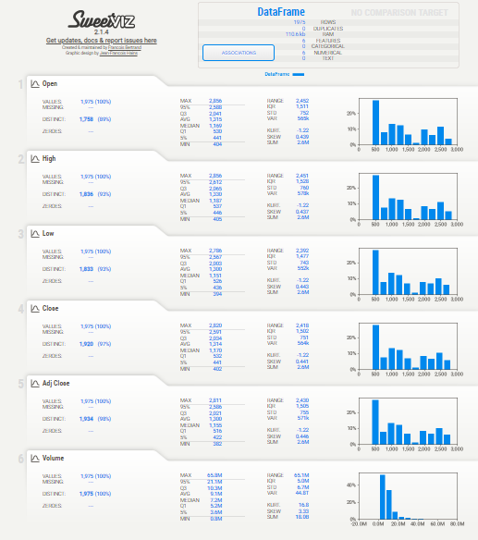
SWEETVIZ

Slide 17
Model Building
In order to simulate the new, unseen data, the available data is subjected to data splitting whereby it is split to 2 portions (sometimes referred to as the train-test split). Particularly, the first portion is the larger data subset that is used as the training set (such as accounting for 80% of the original data) and the second is normally a smaller subset and used as the testing set (the remaining 20% of the data). It should be noted that such data split is performed once.
Next, the training set is used to build a predictive model and such trained model is then applied on the testing set (i.e. serving as the new, unseen data) to make predictions. Selection of the best model is made on the basis of the model’s performance on the testing set and in efforts to obtain the best possible model, hyperparameter optimization may also be performed.
Cross validation is a technique used in machine learning to evaluate the performance of a model on unseen data. It involves dividing the available data into multiple folds or subsets, using one of these folds as a validation set, and training the model on the remaining folds. This process is repeated multiple times, each time using a different fold as the validation set. Finally, the results from each validation step are averaged to produce a more robust estimate of the model’s performance.
The main purpose of cross validation is to prevent overfitting, which occurs when a model is trained too well on the training data and performs poorly on new, unseen data. By evaluating the model on multiple validation sets, cross validation provides a more realistic estimate of the model’s generalization performance, i.e., its ability to perform well on new, unseen data.

Slide 18
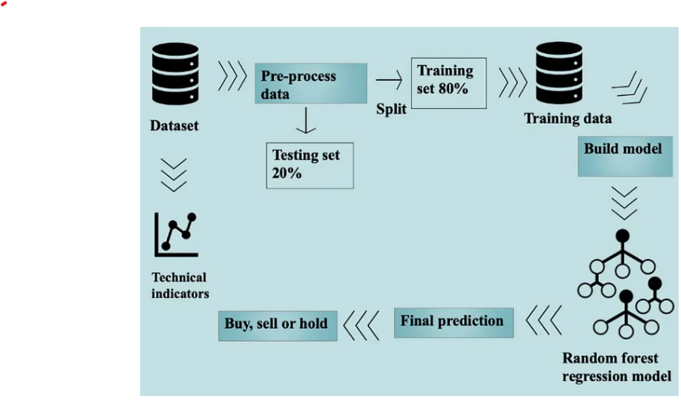
Flow chart for the whole process

Slide 19
Linear Regression
Linear regression is a statistical method for modelling relationships between a dependent variable with a given set of independent variables.
In building linear regression model, only main features are selected and these features are split into testing and training set for model building.
Close price is selected as the target variable for this model.
After splitting data into training and testing sets, Linear regression model is created by using the training dataset which will be fitted for better accuracy.
Predictions are made on the testing set.
By using predictions we can find out error
To increase r-squared values we used transformation models (Log transformation, Exponential transformation, Sqrt transformation, Quard transformation)
We used model validation techniques to cross verify my model is good are not
Mean = 0, standardized residuals values are constant variance from mean value , valid model.
Mean absolute error of the model is 2.59526.
Mean Squared error is 10.61845.
R2 Score is 0.999817.

Slide 20
Support Vector Machine Model
Support Vector Machine or SVM is one of the most popular Supervised Learning algorithms, which is used for Classification as well as Regression problems. However, primarily, it is used for Classification problems.
SVM chooses the extreme points/vectors that help in creating the hyperplane. These extreme cases are called as support vectors, and hence algorithm is termed as Support Vector Machine.
Similar to Linear regression model in SVM model data is split into training and testing sets.
Close price is selected as the target variable for this model.
After splitting data into training and testing sets, Linear regression model is created by using the training dataset which will be fitted for better accuracy.
Predictions are made on the testing set.
By using predictions we can find out error.
R2 value of the model is -0.0562811.
Mean Absolute Error of the model is 657.734681.
Mean Squared error of the model is 614872.56214.

Slide 21
ARIMA Model
ARIMA is an acronym for “autoregressive integrated moving average.” It’s a model used in statistics and econometrics to measure events that happen over a period of time. The model is used to understand past data or predict future data in a series. It’s used when a metric is recorded in regular intervals, from fractions of a second to daily, weekly or monthly periods.
An ARIMA model has three component functions: AR (p), the number of lag observations or autoregressive terms in the model; I (d), the difference in the nonseasonal observations; and MA (q), the size of the moving average window. An ARIMA model order is depicted as (p,d,q) with values for the order or number of times the function occurs in running the model. Values of zero are acceptable.
Similar to Linear regression model in ARIMA model data is split into training and testing sets.
Close price is selected as the target variable for this model.
After splitting data into training and testing sets, ARIMA model is created by using the training dataset which will be fitted for better accuracy.
Predictions are made on the testing set.
By using predictions we can find out error.
Testing Mean Squared Error of the model is 1581.967.
Symmetric Mean Absolute percentage error is 1.212.

Slide 22
Random Forest Model
Random Forest is a popular machine learning algorithm that belongs to the supervised learning technique. It can be used for both Classification and Regression problems in ML. It is based on the concept of ensemble learning, which is a process of combining multiple classifiers to solve a complex problem and to improve the performance of the model.
Random Forest is a classifier that contains a number of decision trees on various subsets of the given dataset and takes the average to improve the predictive accuracy of that dataset.
The greater number of trees in the forest leads to higher accuracy and prevents the problem of overfitting.
Similar to Linear regression model in Random Forest model data is split into training and testing sets.
Close price is selected as the target variable for this model.
After splitting data into training and testing sets, Random Forest model is created by using the training dataset which will be fitted for better accuracy.
Predictions are made on the testing set.
By using predictions we can find out error.
Mean absolute error of the model is 2.36722.
Mean Squared Error of the model is 12.09262.
R2 Score of the model is 0.999979.

Slide 23
Long Short Term Memory Networks(LSTM)
An LSTM recurrent unit tries to “remember” all the past knowledge that the network is seen so far and to “forget” irrelevant data.
Each LSTM recurrent unit also maintains a vector called the Internal Cell State which conceptually describes the information that was chosen to be retained by the previous LSTM recurrent unit.
A Long Short Term Memory Network consists of four different gates for different purposes which are Forget gate, Input gate, Input Modulation Gate, Output gate.
Similar to Linear regression model in LSTM model data is split into training and testing sets.
Close price is selected as the target variable for this model.
After splitting data into training and testing sets, LSTM model is created by using the training dataset which will be fitted for better accuracy.
In building LSTM model Keras model is used.
Data is transformed into fit transformation for better accuracy.
Model is tested and predicted for providing accuracy.
Mean Square Error of the model is 1596.55.
Root Mean Square Error of the model is 39.96.

Slide 24
SUMMARY OF MSE VALUES OF DIFFERENT MODELS
S.NO | NAME OF THE MODEL | MSE VALUE
1 | LINEAR REGRESSION | 10.618
2 | ARIMA | 1581.967
3 | SUPPORT VECTOR MACHINE | 614872.562
4 | RANDOM FOREST | 12.089
5 | LONG SHORT TERM MEMORY NETWORKS(LSTM) | 1122.04
Random Forest model is the best model among all models built and it will be taken for Model Building, As the Mean Square Error of the Random Forest model is Minimum

Slide 25
MODEL DEPLOYMENT
Streamlit is a popular open-source Python framework used for building data-driven web applications. It is designed to create interactive web applications that can be easily shared and deployed.
With Streamlit, we can create simple and powerful web applications for data analysis, visualization, and machine learning.
In deploying Random Forest model using Streamlit, we have followed these steps:
Train your Random Forest model using Python. This can be done using a variety of tools, including sklearn, streamlit module.
We have used streamlit tools for model deployment in the app building like plotting and interface.
We have created a Streamlit app that loads trained model and provides a user interface for users to input data and get predictions.
We have saved our built streamlit code of Random forest model in .py file to deploy it in Anaconda prompt.
In Anaconda prompt we have given the path of saved .py file and using streamlit run in Anaconda prompt we have executed our model deployment.

Slide 26
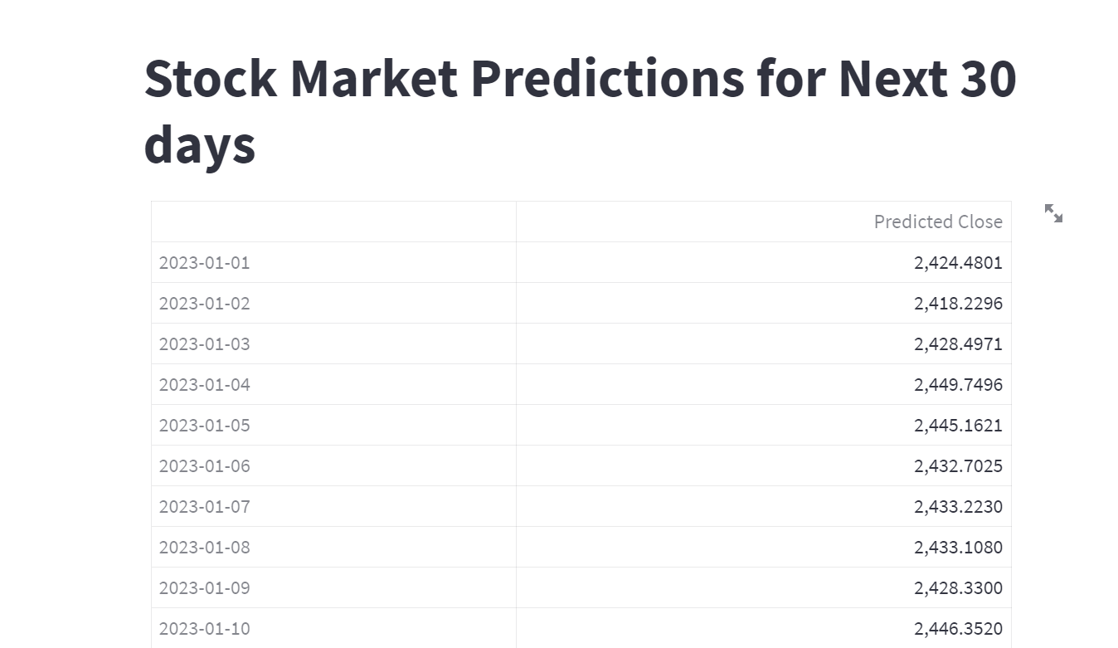

Slide 27
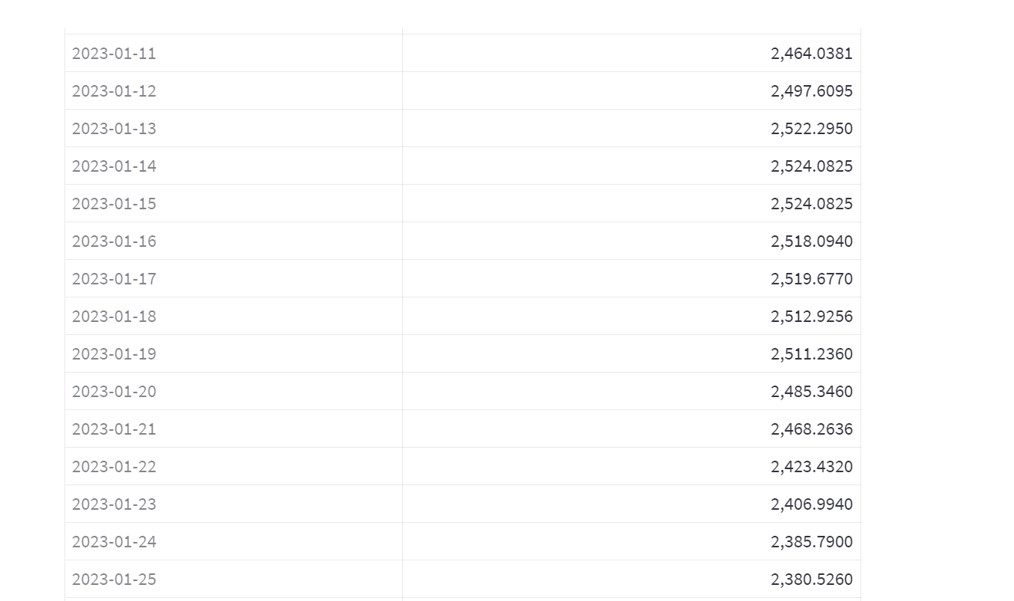

Slide 28
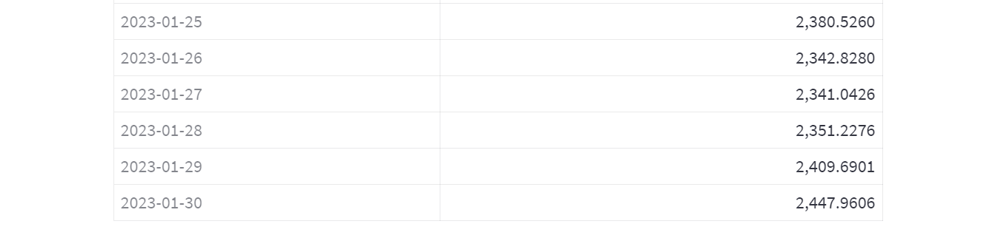

Slide 29
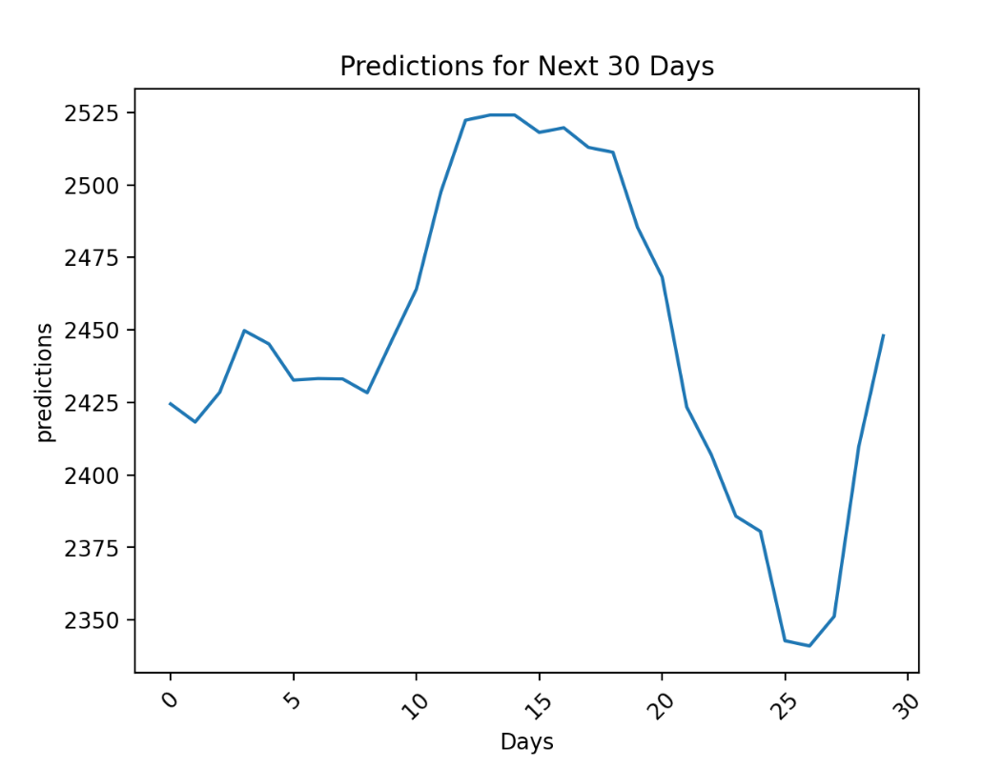

Slide 30
Challenges Faced
We have faced some troubles while deploying the model after it has been built.
While deploying model there were issues with data it worked fine till model building while deployment we have noticed that date columns have some issue(date column was flipped upside down), so we have swapped the web scrapped data with yfinance modules data.
We got issues while building LSTM model, we cross verified and resolved our issue.
We got predicted values way less than the previous values, so we have changed the model from linear regression to random forest.
While deployment using streamlit there was issue with dates as it is in datetime format, we resolved it with using strftime function and using this datetime is converted string and then to numeric with using loops.

